Slide 1



Flick Finder Project
Team Members:
Under SuperVision Of:
Salma Mohamed Abd El Moneim
Nancy Ahmed Mostafa
Sama Ahmed Saeed
Roqya Mohammed Ramadan
Kirollos Maged Lamey
Eng. Fady Sameh
Eng. Joseph Gayed

Slide 2

Table of contents
01
Introduction
04
What sets us apart
02
Problem Definition
05
Future Work
03
Objective
06
Demo

Slide 3


01
Inroduction

Slide 4


Introduction
Increasing Complexity of Movie Information: The growing number of movies and cinema listings across various platforms makes it difficult for users to access all relevant information in one place.
Need for Centralization: Moviegoers often face the challenge of navigating multiple apps or websites to find out about movie showtimes, ticket prices, and nearby cinemas.
Mobile App Solution: Flick Finder aims to address this gap by providing a centralized, real-time platform that offers movie listings, cinema locations, and ticket prices in an intuitive and user-friendly format.

Slide 5

02
Problem Definition

Slide 6



Problem Definition
Fragmented Movie Information:
Users struggle to find comprehensive and up-to-date movie details across multiple platforms, leading to a disjointed experience.
Time-Consuming Process:
The need to switch between multiple apps or websites to gather movie information, locations, and pricing consumes users’ time and adds unnecessary complexity to their moviegoing experience.

Slide 7

03
Objectives

Slide 8






Objectives
Provide Comprehensive Movie Listings
Show Cinema Locations
Display Ticket Prices
Enable Favorite Movie Selection

Slide 9

04
What sets us apart ?!

Slide 10


What sets us apart
Centralized Approach
Users will no longer have to visit multiple websites for movie details, locations, or pricing, reducing the time and effort needed for movie planning.
Personalized Features
The favorites list function will allow users to curate their own movie experience by marking films they wish to watch, offering a tailored movie discovery journey.

Slide 11

05
Future Work

Slide 12

Solutions
Push Notifications for New Movie Releases
Implement push notifications that alert users about new releases, promotions, or changes in movie showtimes.
Advanced Filtering and Recommendation System
Introduce smart algorithms that recommend movies based on user preferences and viewing history, making the app even more personalized and relevant.
In-App Ticket Purchasing
Integrate a feature that allows users to book movie tickets directly through the app, providing a one-stop solution from movie discovery to booking.
Social Sharing Features
Enable users to share their favorite movies or planned cinema visits with friends via social media platforms or directly within the app, enhancing engagement.

Slide 13

06
Demo

Slide 14

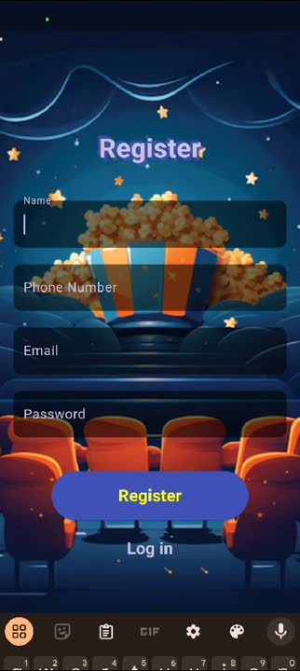


Slide 15


Any Questions?

Slide 16
Thanks!!

